Slide 1
Unit4: Basic approaches to translation
Data structures

Slide 2
Data Structures
Collection of data type ‘values’ which are stored and organized in such a way that it allows for efficient access and modification.
Can become the underlying implementation for a particular data type.

Slide 3
Data Structures
Composite data types
Composed of primitive data types and/or other composite types,
Abstract data types
Set of behaviours for which a particular data structure can be used as the concrete implementation for that data type.

Slide 4
Forms Data Structures
Linear
arrays, lists
Tree
binary, heaps, space partitioning
Hash
distributed hash table, hash tree
Graphs
decision, directed, acyclic

Slide 5
Arrays
Finite group of data, which is allocated contiguous (i.E. Sharing a common border) memory locations, and each element within the array is accessed via an index key (typically numerical, and zero based).
One-dimensional arrays
Multi-dimensional arrays.
Static array
Dynamic array

Slide 6

Linked Lists
Order of the elements within the list are not determined by a contiguous memory allocation.
Data “linked up in a chain”.
Insertions and removals are possible anywhere in a linked list.

Slide 7
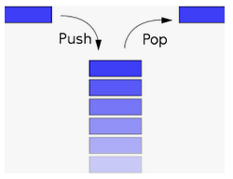
Stacks
Similar to a linked list but insertions and removals are only possible at the top of the stack.

Slide 8
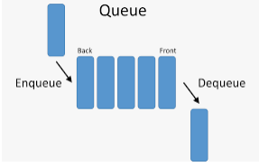
Queue
Similar to a linked list but insertions are only possible at the back and removals at the front.

Slide 9
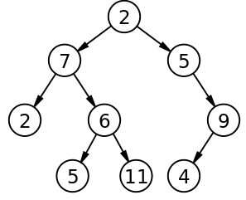
Binary Tree
A hierarchical structure in which a (parent) node has at most two children nodes.

Slide 10
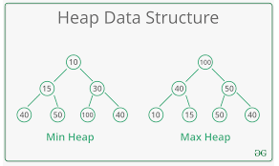
Heaps
Complete or almost complete binary tree, where the child of each node is equal to or smaller in value than the value of its parent.

Slide 11
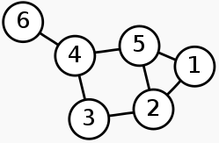
Graphs
Abstract data type intended to guide the implementation of a data structure following the principles of graph theory.

Slide 12
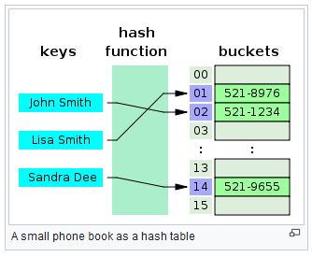
HASH TABLES
Implements an associative array abstract data type, a structure that can map keys to values.

